Slide 1
Post-Test Analysis:
System Check
ENGR Academic Coaching Team
ENGR Academic Coaching Team

Slide 3
Our Time Today
Post-Test Reflection & Analysis
Post-Test Strategies
Atomic Habits (Video)
Goal Committment
Notes:
Today we’re going to spend time looking back on the first round of tests- the good, the bad, and the will-be-better-next-time.
We’ll start with a grounding exercise, in true academic coaching fashion even though they aren’t here in person, and then will have time to reflect and analyze your first college exams.
From there, you’ll watch a video of McKenzie and Rachel exploring some helpful post-test strategies to consider as midterms approach. You’ll walk away from this drill with a clearly defined goal to help you be more prepared for the next round of tests.

Slide 4
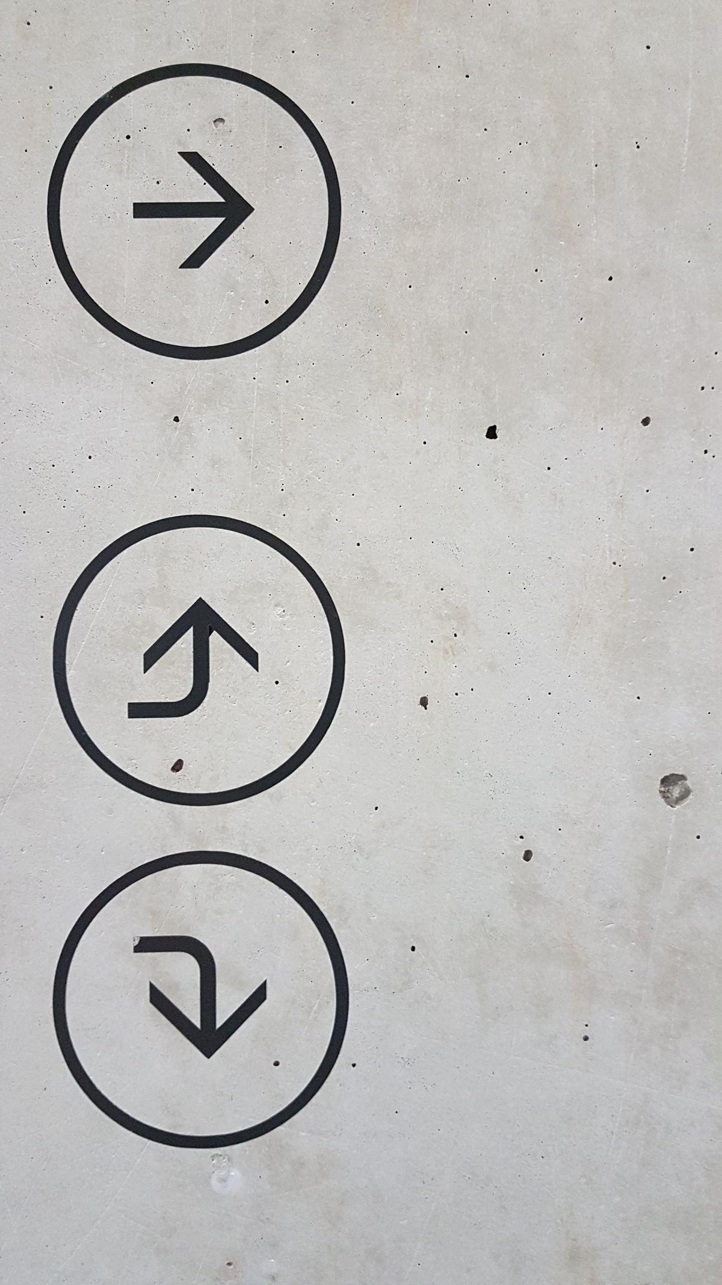
What you will need:
- Blank sheet of paper (or Word Doc)
- Something to write with
Notes:
Agenda- Needs to be changed based on what you all actually cover

Slide 5
Make the Plan​
METACOGNITION
Notes:
Remember metacognition? It means “thinking about how you’re thinking.” The post-test analysis is another way to engage with metacognition. Today’s drill will focus on the “reflect and adjust” box on the bottom right- “What would I change or do differently next time?”
Your first round of exams gave you lessons and ideas for next time, whether the outcome was what you wanted or not.

Slide 6
EXAM
OVERWHELMING
HABITS NEEDS TO CHANGE
PREPARED
SUCCESS
CRAMMING
DISAPPOINTMENT
Notes:
What come to mind when you think about your first exams? What words? Feelings, emotions, lessons?
I’m going to show a series of words and I want you to raise you hand if the word applies your first round of exams.
Was it… (read words- a new word will appear with each mouse click)
Is there any other words that weren’t on the slide that you’d like to add?

Slide 7
What is a System?
"Interconnected or related parts working together for a common purpose (goal)." -Dr. Eric Specking
System
Input
-Time
-Content
-Resources
-Person/Self-Care
Output
- Grades
- Understanding
Notes:
We assessed these four inputs, (time, content, resources and you as a person).
Today we are going to assess our inputs through the tweak post test systems check worksheet.

Slide 8
Retrospective Postassessment
Choose one of your recent exams and evaluate.
1. What went well?
Eat breakfast? Prepare in advance? Bring all your materials? Remember those challenging equations? Write down anything you can think of that went well in the preparation for and actual execution of the exam.
2. What went poorly?
Feel underprepared? Oversleep? Experience test anxiety and blank out? Write down anything that did not go as you had hoped on the exam.
Notes:
Choose any of your recent exams, preferably a math or science, and reflect on these two items:
Examples can include anything from how challenging the test was or wasn’t) to how they prepared for it (or didn’t).
Now, turn to your neighbor and share your reflections about that experience- what surprised you about the first round of exams? Share what went well and what didn’t go so well.

Slide 9
Notes:
When your preparation did not match the outcome
What: This Is an exercise to evaluate where your system may have been not operating at its optimum capacity.
Why: We want to accurately adjust what is needed for the semester to be a success.
How: Think about one class, and reflect on each of these tweak sections.
In a few minutes I will get everyone’s attention and have you share with someone next to you

Slide 10
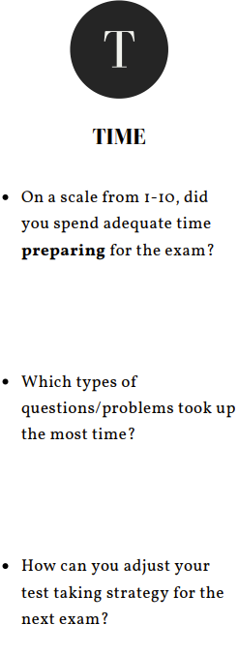

Slide 11
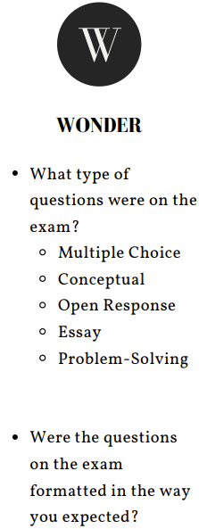

Slide 12
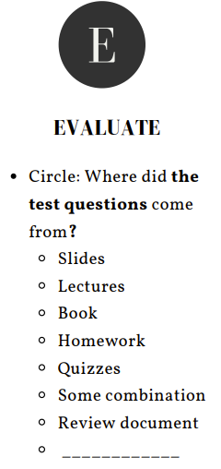

Slide 13
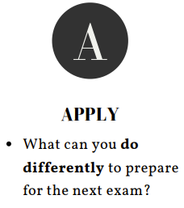

Slide 14
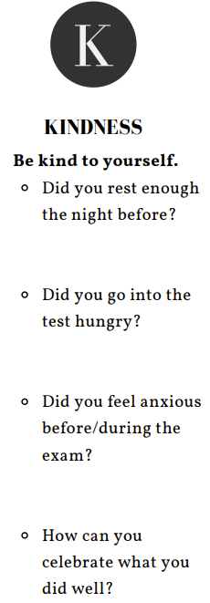

Slide 16
Post-Test Strategies
Evaluate test answers:
Identify themes and patterns
Seek clarification:
Go to office hours/ tutoring to understand problematic concepts
Dress Rehearsals:
Mimic the test environment by taking practice tests at the test location.
Keep your tests
Notes:
Explain the slide and how they can add it to their tweak if needed

Slide 17
Notes:
Explain the slide and suggest them adding it to their TWEAK

Slide 19
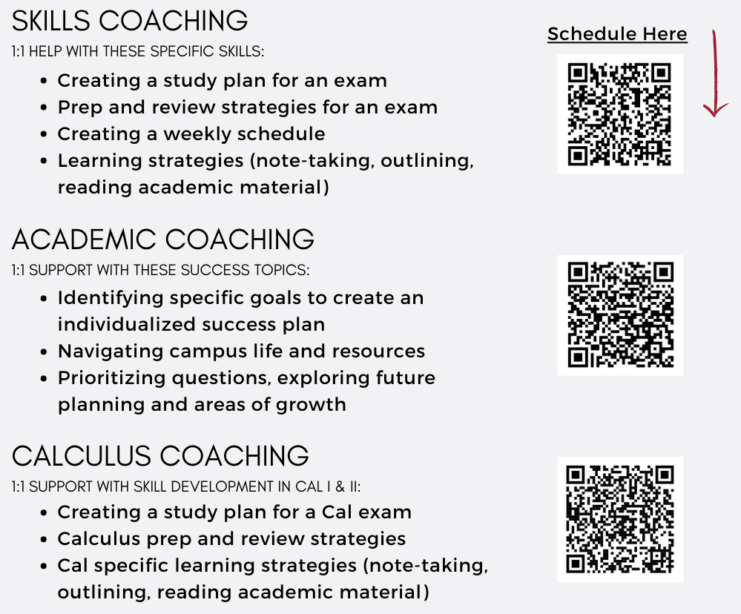
Make an Appointment
Drop-in Hours:
Wed 2-4pm
(ENGR 315)
engcoach@uark.edu

Slide 20
Atomic Habits, James Clear
Notes:
Atomic Habits is a book written by James Clear. Today, we are going to watch this video and you can fill in the blanks.
Stop video at 2:10 (Beginning of stage 2)- Answer question 1 and 2. Talk with your partner about your most important goal for the next three months and explain how you may fail at achieving that goal.
Stop video at 3:12- Answer question 3. How can you design something in your environment to make your good behaviors easier and bad behaviors harder?
Stop video at 6:34-Answer question 4.
Finish video and answer question 5

Slide 21
Commitment:
Based on my first rounds of exams, I want to change _____________ (behavior/habit).
I will adjust my environment to support this by _________________.
I will do __________ (reps) __________ (frequency). When I stop doing
my reps, I will remind myself to start again by _____________.
My short-term feedback/reward will be ____________________.
This change will help me become a _________________
(identity change).
Notes:
“Now we are going to pull it all together. On a separate sheet of paper or on your notes app use the information on your worksheet to decide when, where and how you are going to adjust these behaviors to achieve your goal.

Slide 22
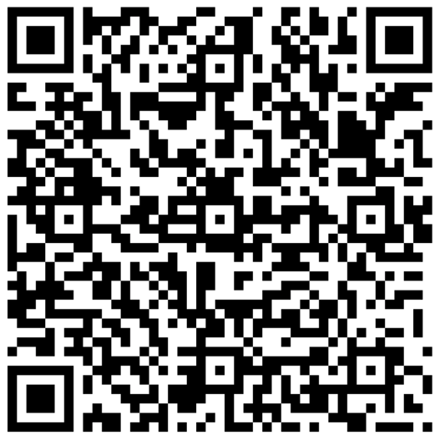
Drill 2:
Sign-Out Survey
Post-Test Analysis:
System Check

